Slide 1
Services
ROS tutorial #3

Slide 2
What are services?
ROS's remote procedure call (RPC)
A node can implement one or more services (server)
Any node can call a service (client)
Calls are synchronous / blocking
Actions are preferred for long-running tasks
GetGripperState request
Node: /remote_control
Node: /robot_state
Response: open

Slide 3
Service messages
Example: GetDistance.srv
string name
---
float64 distance
Must define a .srv message that defines a Request message and a Response message

Slide 4
Service command-line tools
rosservice list
rosservice info /some_service
rosservice call /some_service "param1: 0.0"
rossrv show my_msgs/ServiceName

Slide 5
When to use services?
In many cases, writing a library function is better
Quick operations
For long running functions, use Actions instead
C++ / Python interoperability
When one computer is connected to real hardware

Slide 6
Let's write some code!

Slide 7
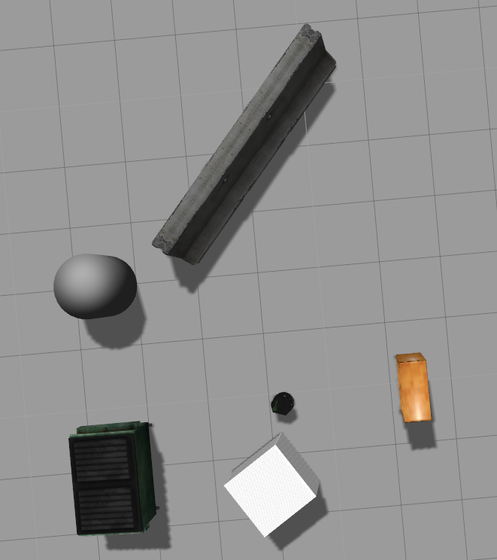
GetDistance and GetClosest
We will create two services
GetDistance will given in the name of a landmark and return the distance to the landmark
GetClosest will return the name of the closest landmark
Barrier
Cylinder
Bookshelf
Dumpster
Cube

